Slide 1
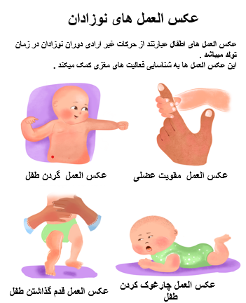
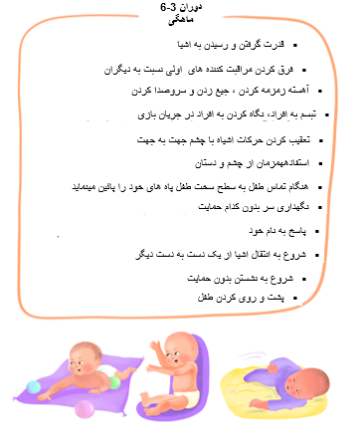
This poster has been created with financial support from the Aga Khan Foundation and Global Affairs Canada, and its content is derived from the Aga Khan University literature

Slide 2
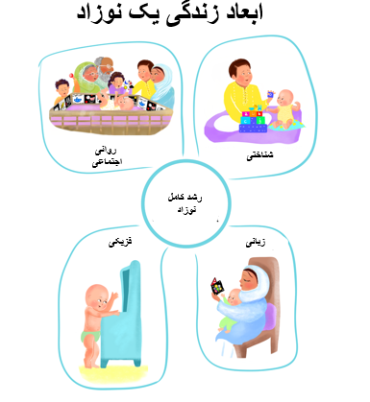
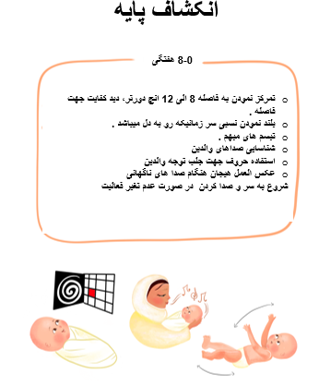
For any questions or information, please contact the Aga Khan Health Services Centre nearest to your area.

